Slide 1
European Rulers in the age of absolutism
By Country

Slide 2
A Time of Empires

Slide 3
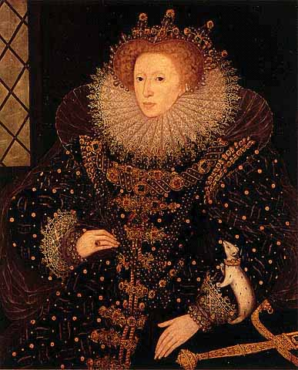
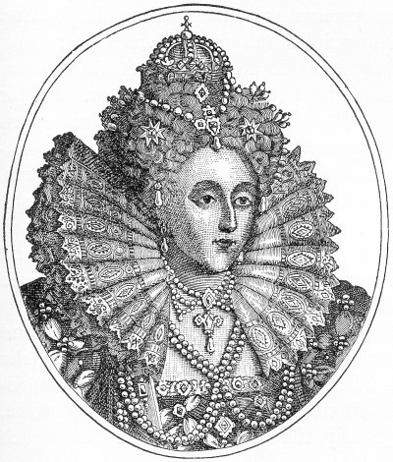
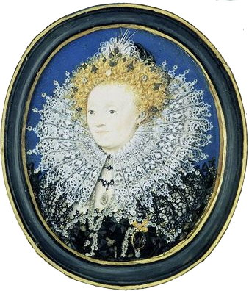
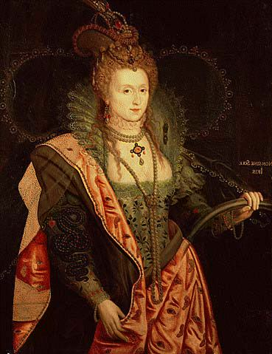
England
Elizabeth I 1533-1603

Slide 4
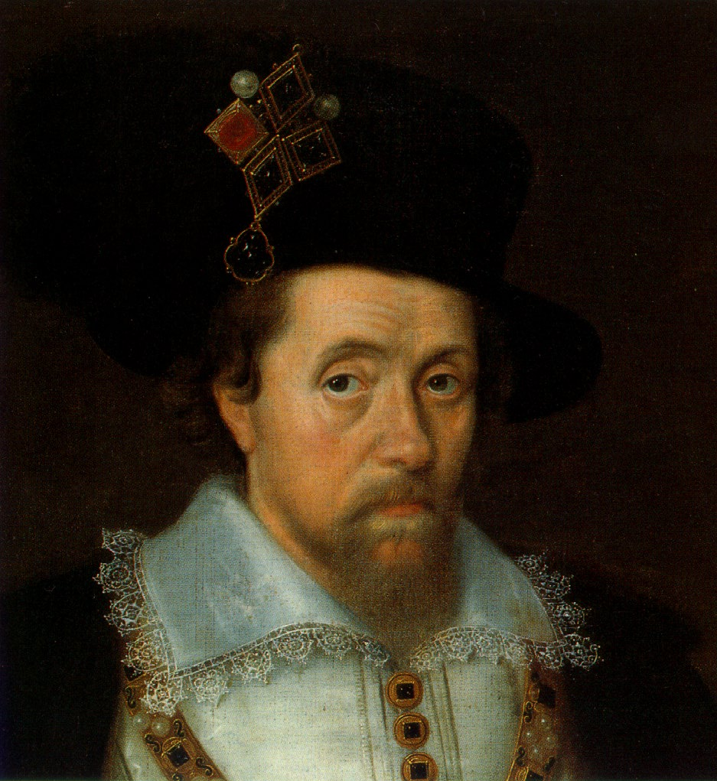
England
James I The 1st Stuart King

Slide 5
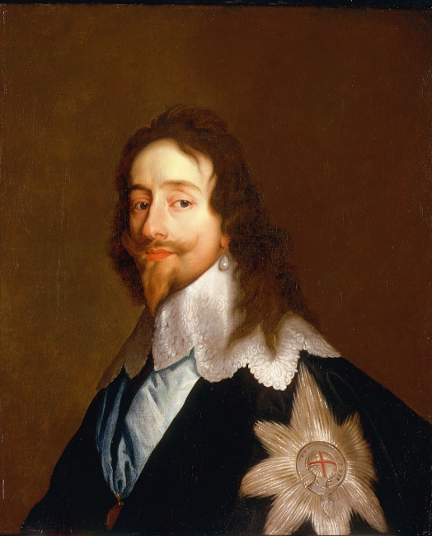
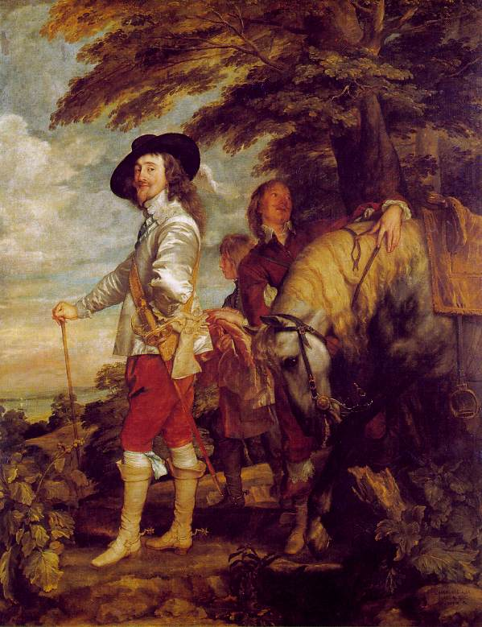
England
Charles I James’ son

Slide 6
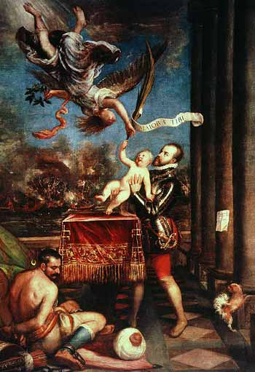
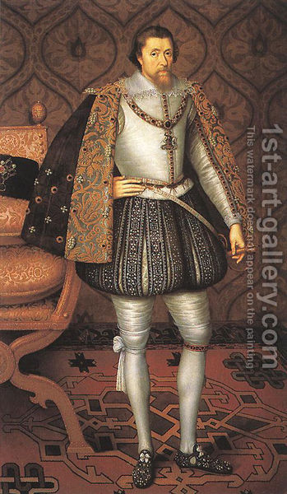
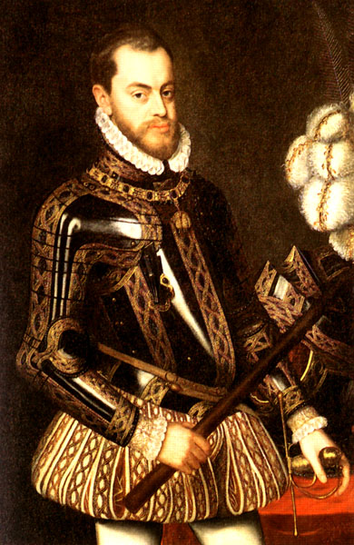
Spain
Philip II Spain—The Golden Age

Slide 7
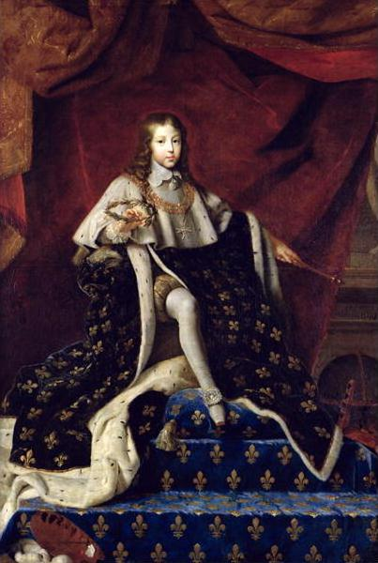
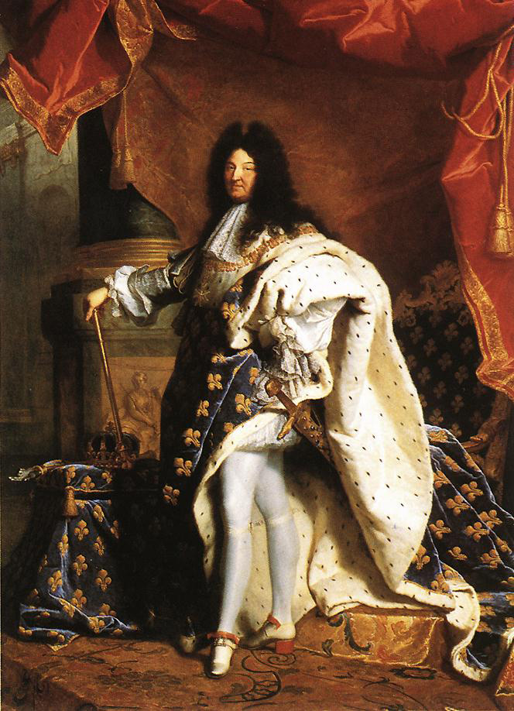
France
Louis XIV– The Sun King

Slide 8
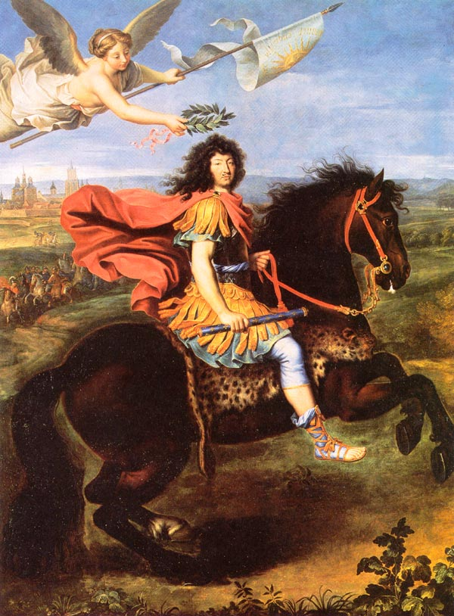
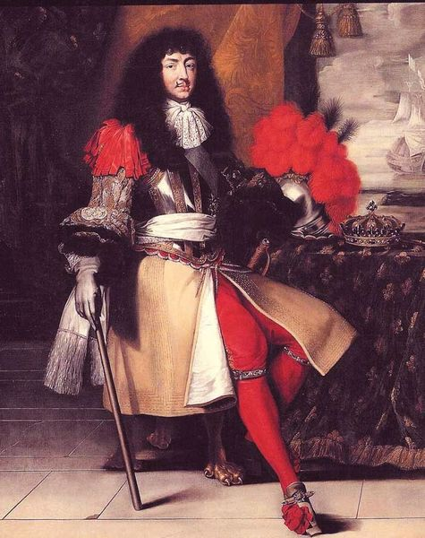
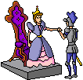
Louis XIV

Slide 9
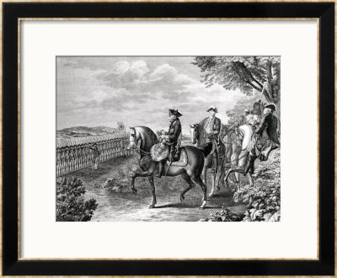
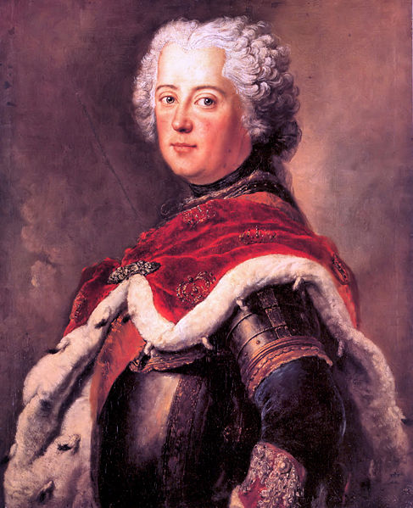
Prussia
Frederick II -- A Hapsburg & Holy Roman Emperor

Slide 10
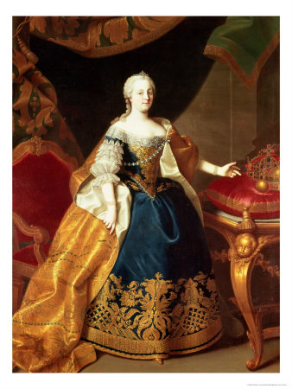
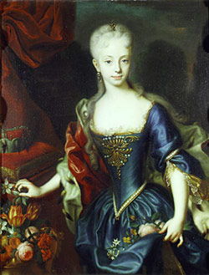
Austria
Empress Maria Theresa

Slide 11
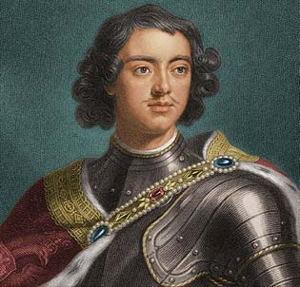
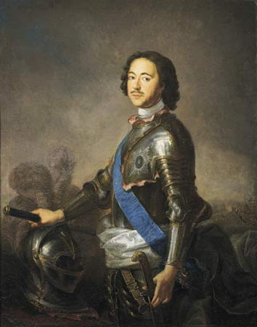
Russia
Peter the Great (Romanov)

Slide 12
This powerpoint was kindly donated to
www.worldofteaching.com
http://www.worldofteaching.com
Is home to well over a thousand powerpoints submitted by teachers. This a free site. Please visit and I hope it will help in your teaching
Notes:
12

